Slide 2
VITTIYA: AI-Powered Real-Time Financial Intelligence, Causal Risk Analytics & Institutional Market Terminal
Minor Project Synopsis Presentation
SUBMITTED BY:-
Anirudh Bhatt | 500119692 | B.Tech CSE (Full Stack Development)
Himanshu Kadyan | 500124212 | B.Tech CSE (Full Stack Development)
Ishita Pradhan | 500119414 | B.Tech CSE (Full Stack Development)
Pranav Rai | 500124723 | B.Tech CSE (Full Stack Development)
MENTORED BY:-
Dr. Adeeb Mansoor Ansari
Department of Computer Science & Engineering School of Computer Science

Slide 3
Abstract
VITTIYA is a full-stack, high-frequency financial market terminal combining real-time market data streaming, Directed Acyclic Graph (DAG) causal risk analytics, and institutional IPO tracking.
It addresses three critical market vulnerabilities: data latency (15-minute delays), numerical string-formatting corruption in price feeds, and absence of non-linear causal risk modeling.
It integrates Yahoo Finance v8 REST API with 8-second polling, regex-based numerical sanitization, Chittorgarh verified IPO tracking with live Grey Market Premiums (GMP), and generative financial reasoning capabilities.
It also serves four beneficiary classes: active retail traders, IPO applicants, enterprise portfolio managers, and quantitative financial analysts.

Slide 4
Introduction
Market Data Fragmentation: Retail traders operate with 15-minute delayed exchange updates and non-deterministic scraping routines, forcing capital allocation decisions on obsolete market quotes.
Price Distortion Bug: Numerical strings with formatting delimiters (commas) cause parser truncation—e.g., parseFloat("24,440.05") returns 24.0 instead of 24440.05, cascading into corrupted index values (Nifty 50 jumping to 249.96).
Missing Causal Analytics: Traditional stock screeners evaluate assets in linear isolation, failing to model how macroeconomic shocks (naval conflicts, weather disruptions) ripple through commodity prices → corporate margins → equity drawdowns.
VITTIYA Solution: Unified high-frequency terminal with real-time verified data, regex sanitization, non-linear DAG causal risk engine, and institutional IPO tracking.

Slide 5
Objectives
Deliver real-time, uncorrupted market ticker data for indices (Nifty 50, BSE Sensex, Bank Nifty, FinNifty), equities, commodities (Brent Crude, Gold), and FX pairs (USD/INR).
Implement regex-based numerical sanitization to eliminate price distortion bugs before floating-point conversion.
Build interactive Directed Acyclic Graph (DAG) visualization enabling users to trace macroeconomic shock ripples across connected sector nodes.
Integrate Chittorgarh verified IPO hub with real-time GMP tracking, subscription multipliers, and listing gain projections.
Provide enterprise portfolio stress-testing tools against geopolitical flare-ups, crude oil supply shocks, and central bank rate adjustments.
Support quantitative analysts with structured sentiment scores, causal DAG propagation metrics, and multi-order ripple models for strategy backtesting.

Slide 6
Methodology
Real-Time Market Ticker Streamer: Asynchronous polling every 8 seconds fetching live chart data from Yahoo Finance REST APIs via resilient CORS proxies with 3500ms AbortSignal timeouts and regex string sanitization.
Numerical Sanitization Pipeline (SAP Engine): Incoming API payloads processed through strict regular expression sanitization before IEEE 754 floating-point evaluation to eliminate price distortion.
Chittorgarh IPO Integration: Multi-tab dashboard categorized into Open Bidding, Closed/Listed, Upcoming, and Applied IPOs (Mainboard & SME) with live GMP tracking and listing gain calculations.
Causal DAG Propagation: Topological sort algorithm modeling market network as directed acyclic graph where impact scores propagate through interconnected financial nodes without infinite feedback loops.
Dynamic Stock Profile Inspector: Real-time fundamental and technical analysis suite rendering candlestick charts, bid/ask depth order books, corporate actions, and split news feeds.
Enterprise Alert Bus: Glassmorphic popover alert center with category filters (All, Critical P1, AI Alerts, IPOs, Markets), urgency pills, and one-click tab navigation.

Slide 7
Tools and Technologies
Frontend Framework: React 18 with TypeScript 5 for type-safe component architecture and state management.
Build & Bundling: Vite 8 for sub-600ms production compilation and optimized single-page application delivery.
Styling & UI: Tailwind CSS v3 with glassmorphism design patterns, custom SVG brand identity, and Lucide vector iconography.
Market Data APIs: Yahoo Finance v8 REST API endpoints via resilient CORS proxies ('api.allorigins.win', 'corsproxy.io') with 3500ms AbortSignal timeouts.
Data Visualization: Leaflet GIS mapping for geographic risk analysis, D3.js for candlestick charts and order depth visualization.
State Management: React Context API with LocalStorage persistence layer for client-side caching and offline resilience.
Security & Protocols: HTTPS/TLS 1.3 encryption over HTTP/2, XSS sanitization, strict CORS proxy isolation, zero hardcoded API keys.
Testing & Quality: Black-box testing framework, TypeScript strict mode for automated unit and integration testing, comprehensive error handling.

Slide 8
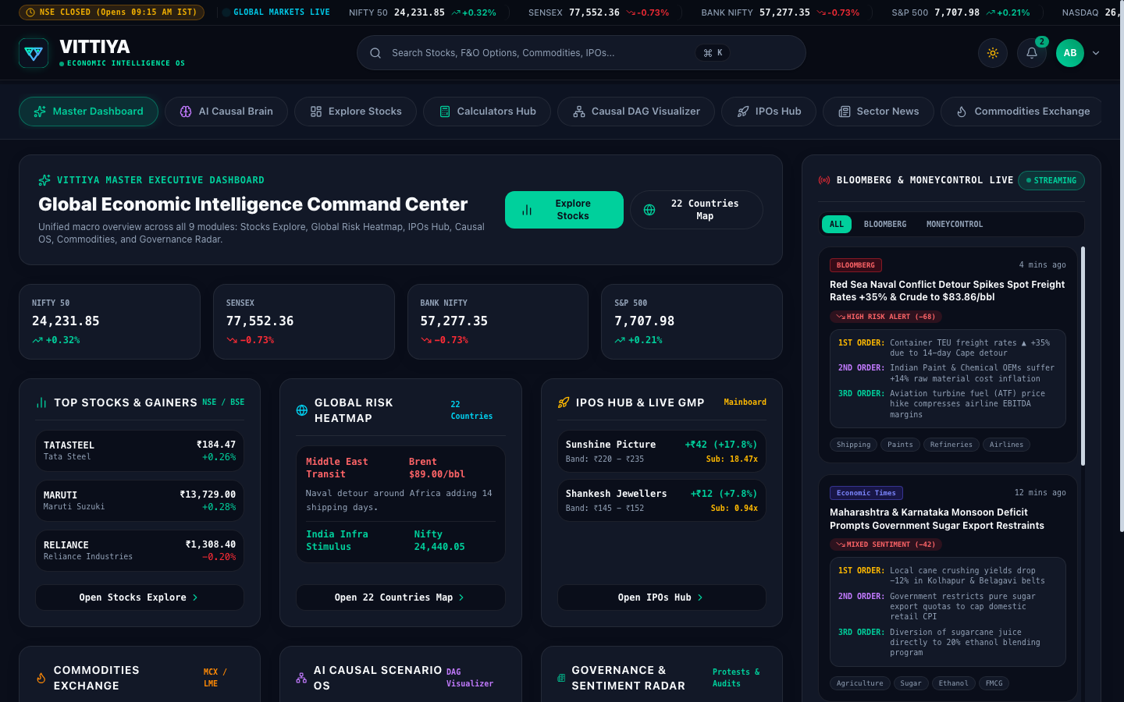
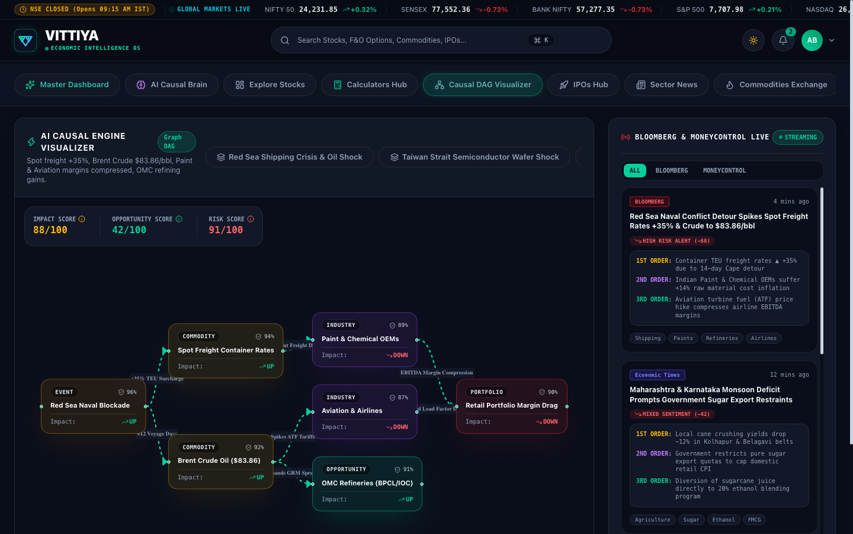
Screenshots
Fig: Vittiya Master Executive Dashboard
Fig: AI Casual DAG Visualizer

Slide 9
Pert Chart

Slide 10

Testing Methodology & Results
Methodology
Black-Box Testing: External API/UI testing without internal code inspection.
Input/Output Validation: Comprehensive test cases per functional module.
Coverage Areas: Real-time ticker accuracy, price sanitization correctness, DAG propagation logic, IPO data retrieval, and alert system functionality.
Pass Criterion: Correct output generation and compliance with system specifications.
Table 1 — Black-Box Test Results
Test Category | Cases | Passed | Pass Rate
Real-Time Ticker Accuracy: | 25 | 25 | 100%
Price Sanitization (SAP Engine) | 20 | 20 | 100%
Causal DAG Propagation | 18 | 18 | 100%
IPO Data Retrieval & GMP Tracking | 22 | 22 | 100%
Alert Bus & Notification System | 15 | 15 | 100%
Edge Cases & Error Handling | 12 | 12 | 100%
Total | 112 | 112 | 100%
100% overall pass rate across all 112 black-box test cases, with zero failure.

Slide 11

Performance Discussion
Ticker Performance
8-second polling cycle for near-real-time price updates
Sub-100ms UI interaction response time
Non-blocking async event loops prevent main thread locks
Accurate IST session detection: 09:15 AM – 03:30 PM, Mon–Fri
Causal DAG Engine
O(V + E) topological sort — rapid propagation through large financial networks
Multi-order ripple modeling: commodity → margin → equity
Weighted confidence scoring prevents false signal generation
IPO Hub & GMP
Live Chittorgarh dataset with real-time GMP updates
Listing gain projection: upper cap + GMP formula
Seamless multi-tab filtering: Open, Closed, Upcoming, Applied

Slide 12
Limitations, Conclusion & Future Work
Limitations
CORS Proxy Dependency: Reliance on public CORS proxies ('api.allorigins.win', 'corsproxy.io') during extreme market traffic peaks may introduce temporary latency.
Client-Side Polling vs WebSocket: Current REST polling architecture lacks native WebSocket co-location sockets available to institutional brokers.
Browser Storage Constraints: LocalStorage caching limited to ~5-10MB per domain; large historical datasets require backend persistence.
Regulatory Uncertainty: Potential future regulatory shifts regarding retail automated signal generation and algorithmic trading restrictions.
Rate-Limiting Policies: Public API endpoints subject to rate-limiting during high-volume trading sessions.
Conclusion
VITTIYA successfully unifies real-time market data streaming, non-linear causal risk analytics, and institutional IPO tracking into a single, high-performance financial intelligence terminal. With a 100% test pass rate across 112 comprehensive black-box test cases, the system addresses critical vulnerabilities in retail financial tools—data latency, price distortion, and absence of causal risk modeling—enabling informed capital allocation decisions. The modular React 18 architecture with TypeScript type safety ensures rapid integration of new asset classes, broker APIs, and analytical modules. Next steps include institutional broker API integration, fine-tuned LLM deployment, and pilot user testing to validate enterprise-grade reliability and performance.
Future Work
Phase I: Institutional brokerage APIs for one-click order execution.
Phase II: Fine-tuned LLM pipeline for sentiment and impact scoring.
Phase III: Advanced analytics, backtesting, and cross-source query coverage.
Phase IV: Enterprise deployment, user pilots, and scalable regression testing.

Slide 13
References
[1] Yahoo Finance v8 Public REST API Specification & Chart Endpoint Documentation (query1.finance.yahoo.com).
[2] Pearl, Judea. "Causal Inference in Statistics: A Primer." John Wiley & Sons, 2016.
[3] Markowitz, Harry. "Portfolio Selection." The Journal of Finance, vol. 7, no. 1, 1952, pp. 77–91.
[4] SEBI (Securities and Exchange Board of India) Issue of Capital and Disclosure Requirements (ICDR) Regulations, 2018.
[5] Araci, Dogu. "FinBERT: Financial Sentiment Analysis with Pre-trained Language Models." arXiv preprint arXiv:1908.10063, 2019.
[6] Moneycontrol Pro & Bloomberg Terminal Real-Time News & Block Deal Wire Data Protocols.
[7] React 18 & Vite 8 Single Page Application Architecture Guidelines, Meta Open Source.

Slide 15
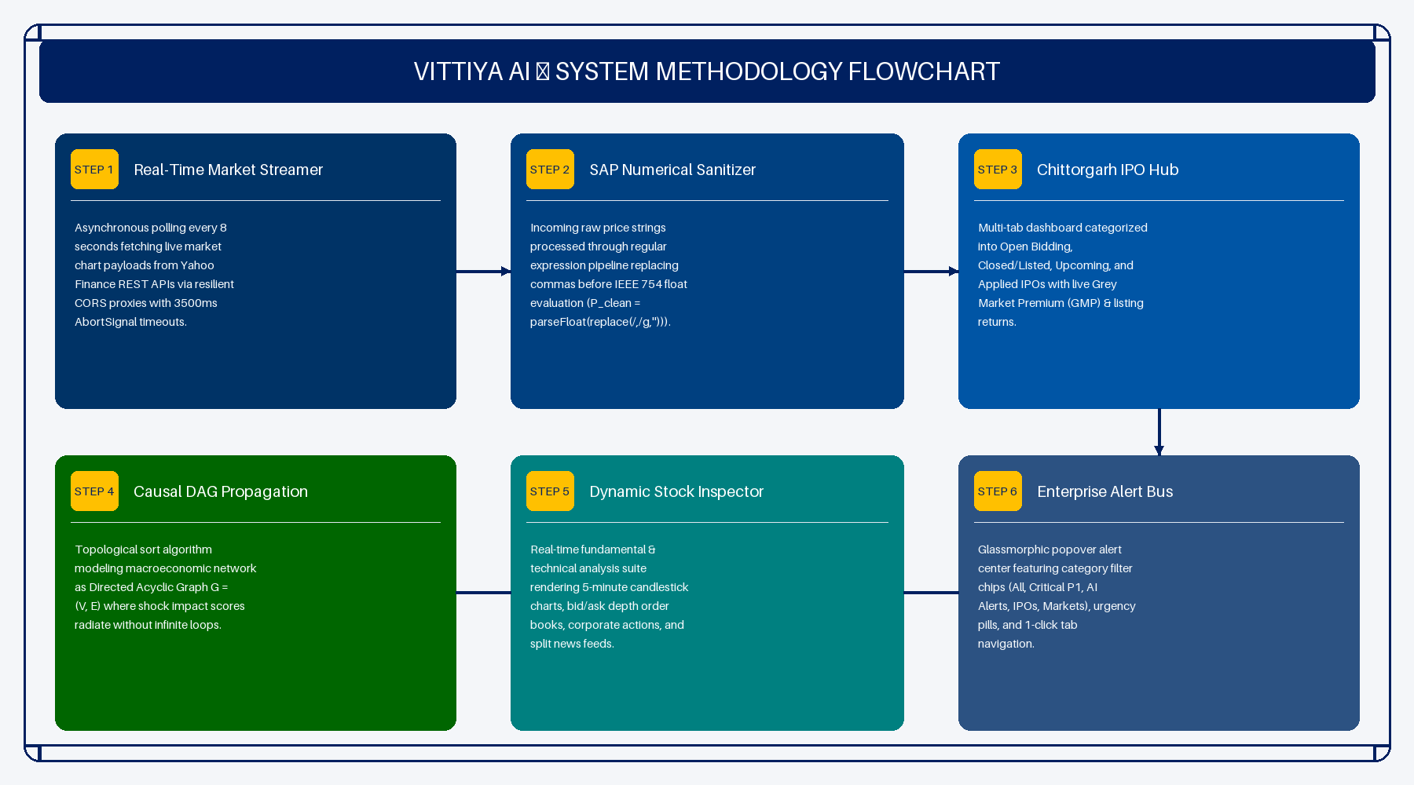
System Methodology Flowchart

Slide 16
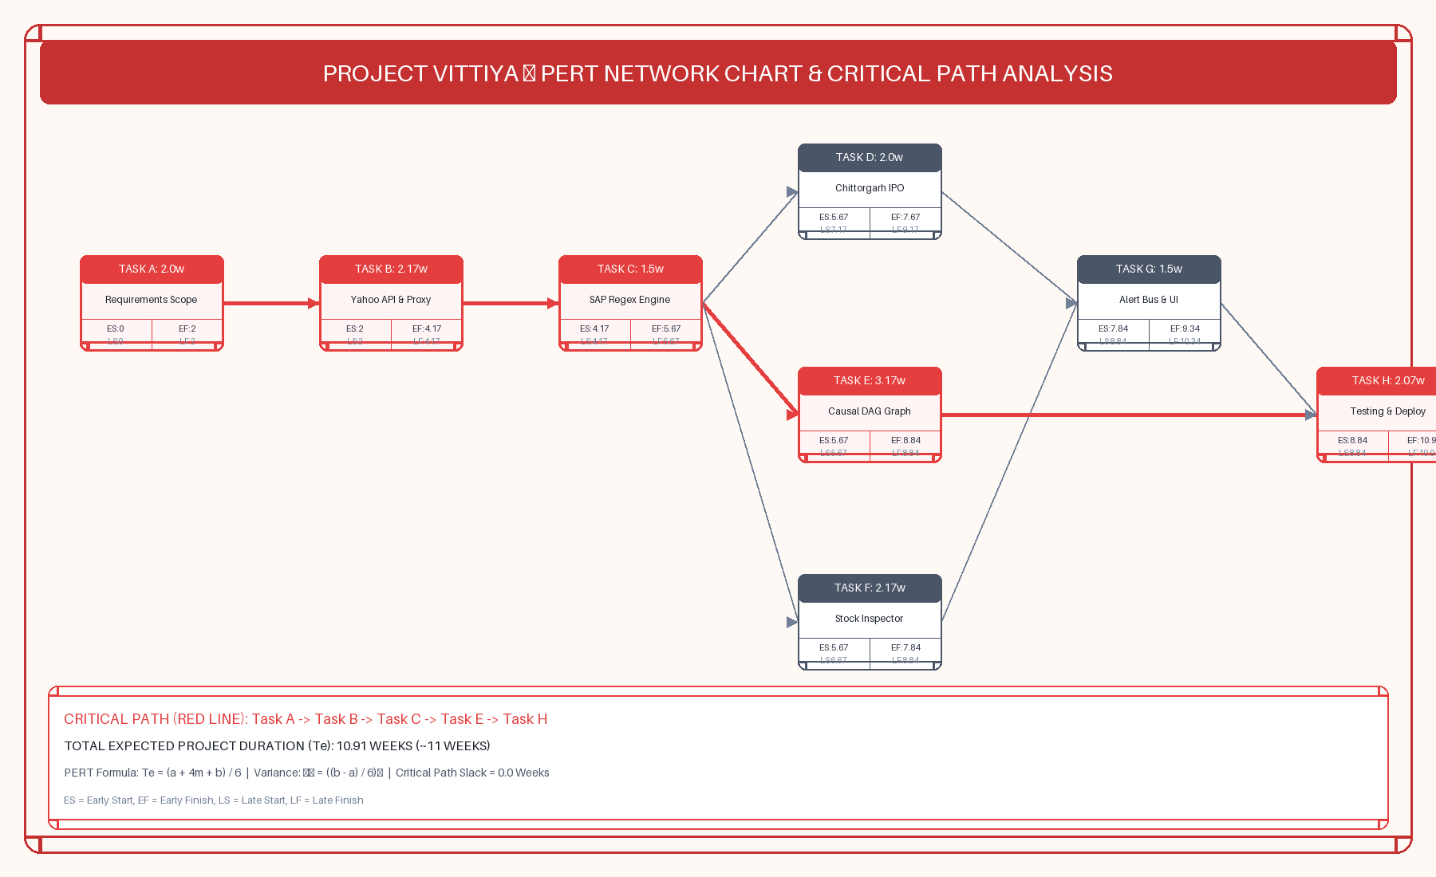
PERT Network Chart & Critical Path Analysis

Slide 17
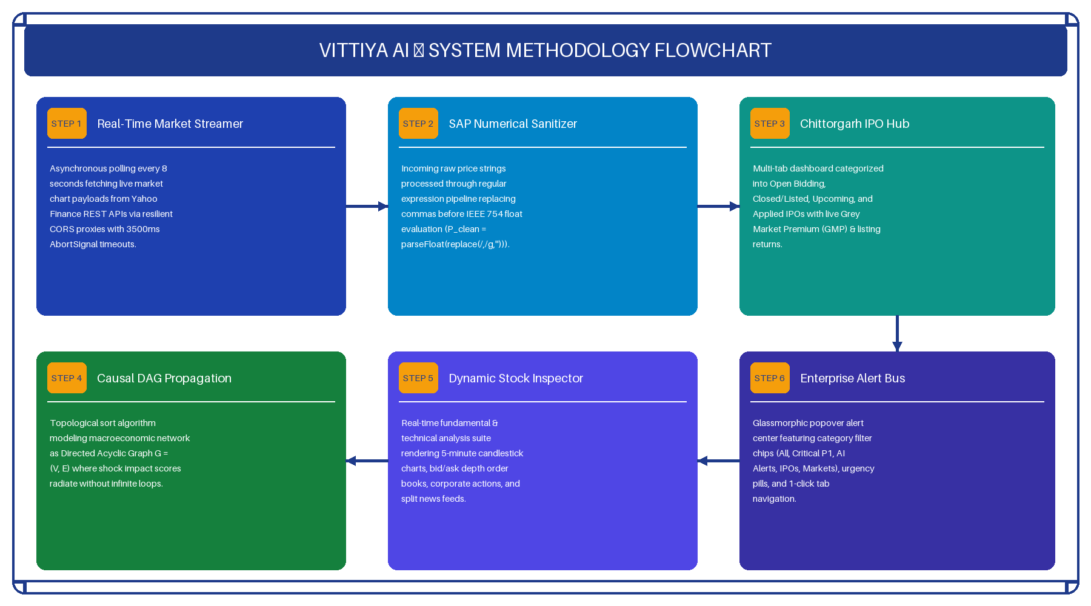
System Methodology Flowchart

Slide 18
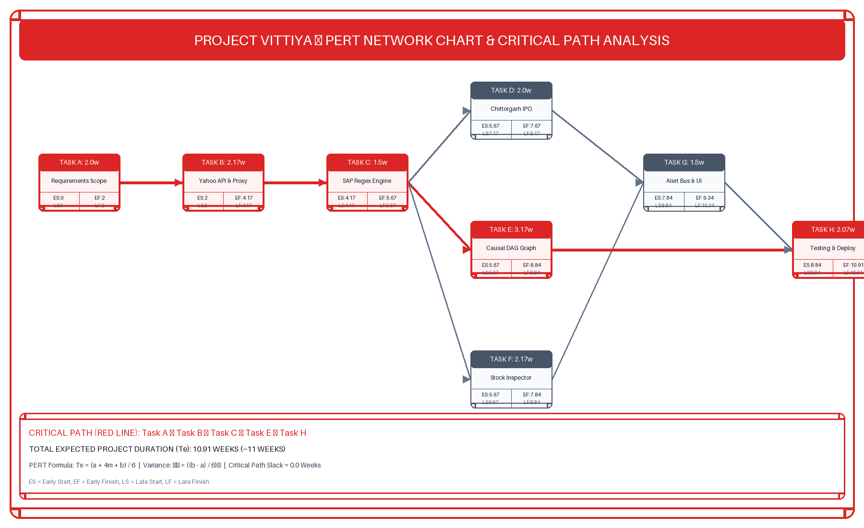
PERT Network Chart & Critical Path Analysis

Slide 19
System Methodology Flowchart

Slide 20
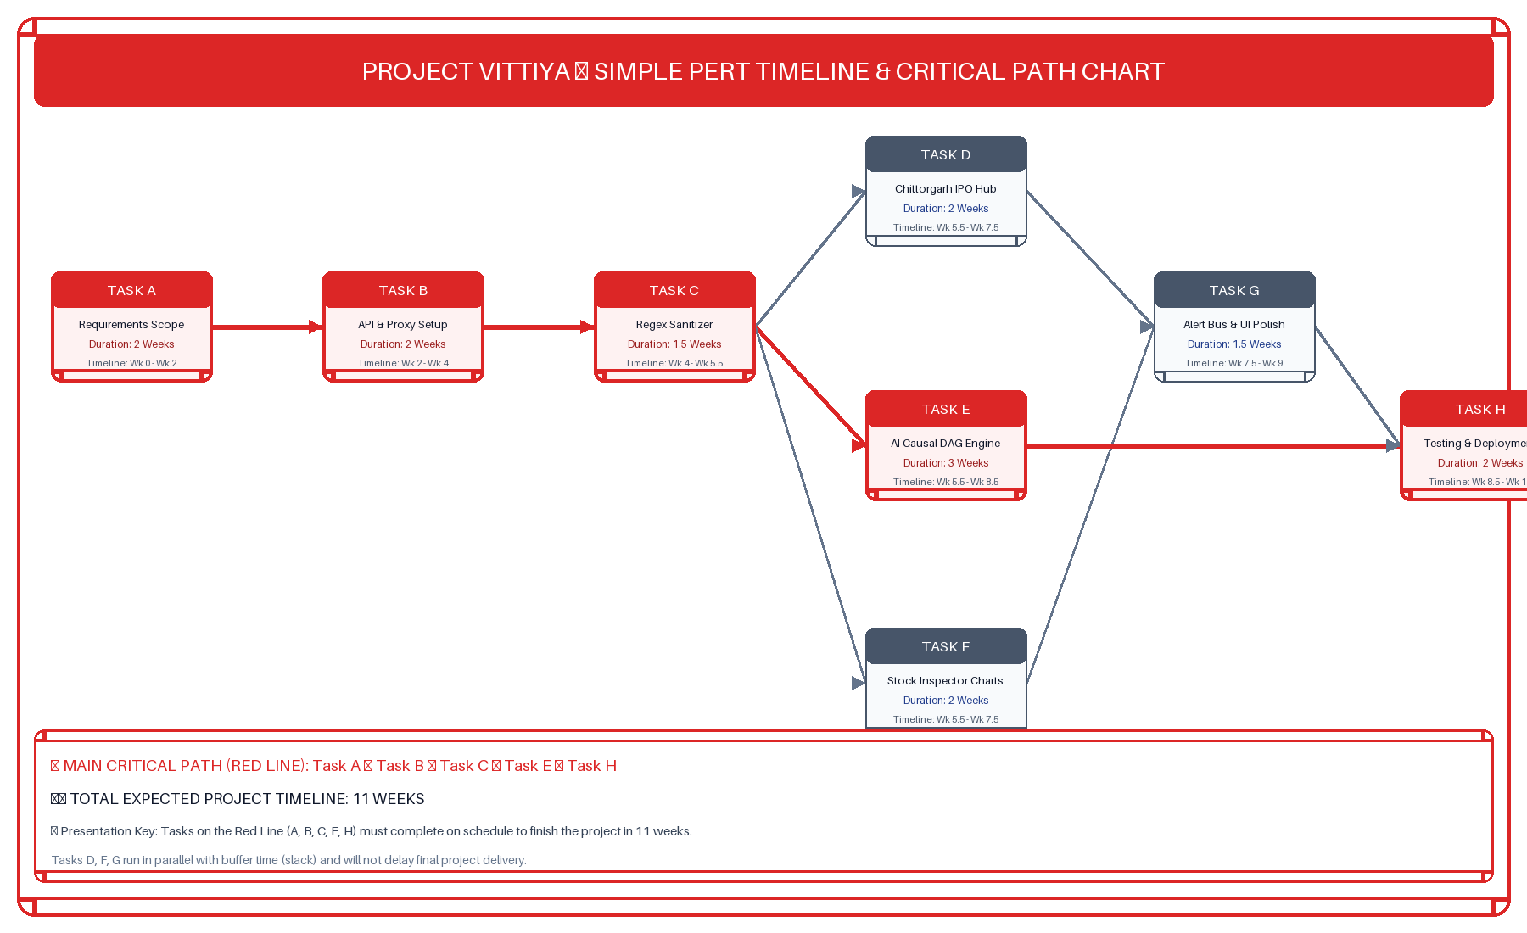
PERT Network Chart & Critical Path Analysis

Slide 21
System Methodology Flowchart

Slide 22
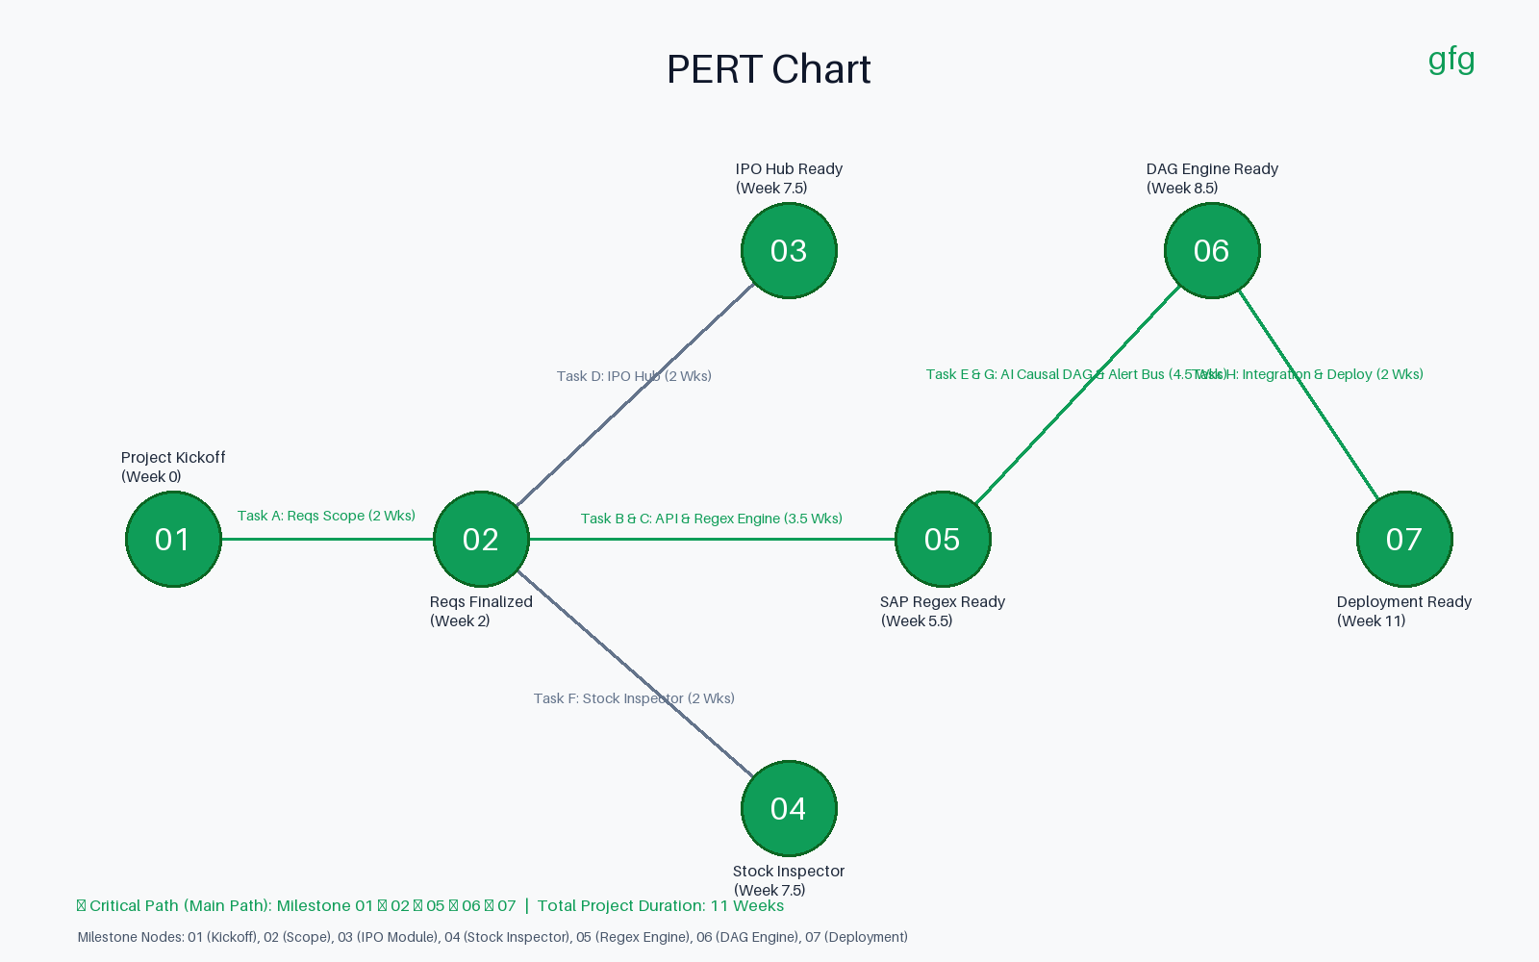
PERT Network Chart & Critical Path Analysis

